Slide 1
Positive Behaviour Supports
Recording – cont’d

Slide 2
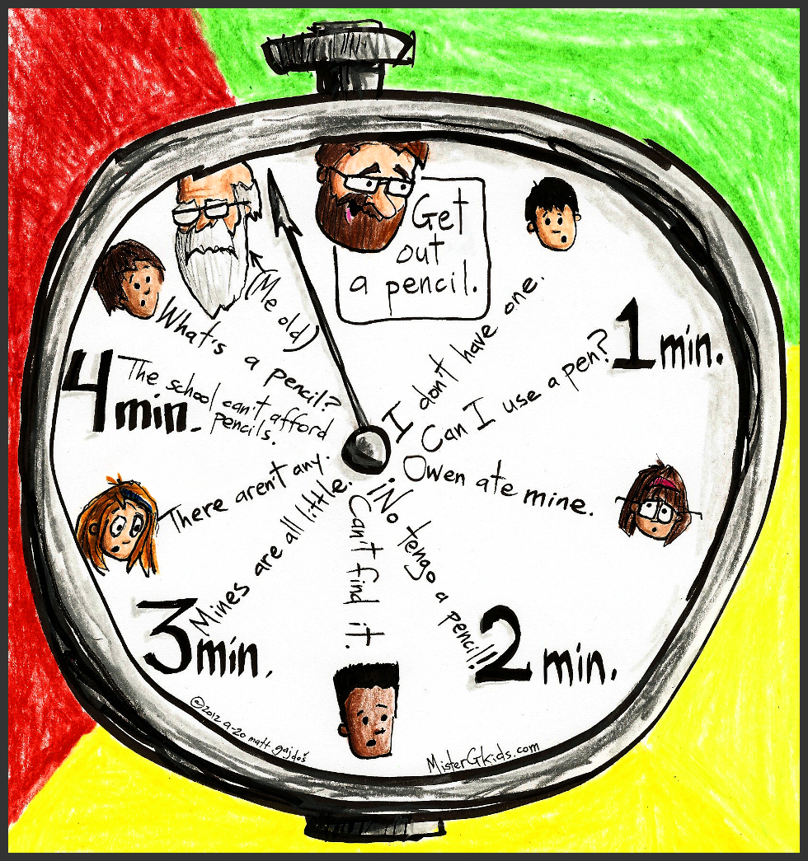
Activity

Slide 3

Duration
Indicates the length of time a specific behaviour occurs
Recording starts at the time the individual begins the behaviour and stops when it ends

Slide 4

Duration
Behaviour needs to have a clear beginning and end
Appropriate for behaviours that are sustained (wandering around class, screaming, time on a computer, etc.)

Slide 5


What do you think?

Slide 6


What do you think?

Slide 7
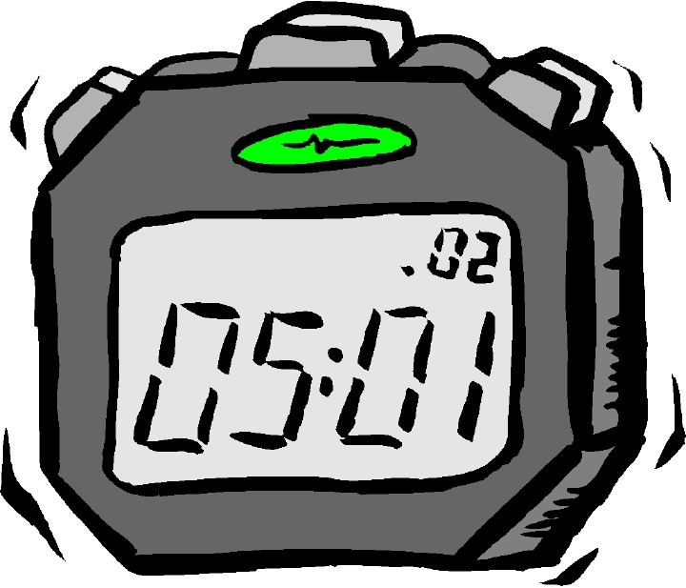
Devices
Requires a clock, wristwatch, stopwatch, cell phone, apps or other timing device

Slide 8
Duration recording: working individually
Date | Start | End | Length of time
11/5 | 9:55 | 10:06 | 11 minutes
11/5 | 10:19 | 10:28 | 9 minutes
11/6 | 9:43 | 9:51 | 8 minutes
11/7 | 10:04 | 10:19 | 15 minutes
11/7 | 10:23 | 10:33 | 10 minutes

Slide 9
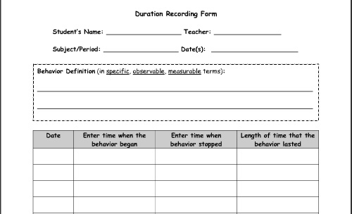
Recording Form

Slide 10
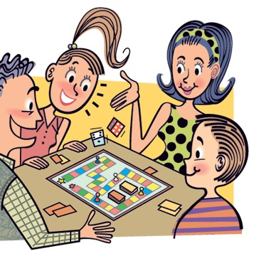
Activity

Slide 11
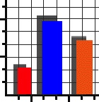
Graphing
Makes it easier to quickly review the data and to see changes
Can summarize several observations on one page
Effective way to share feedback / progress to students and families

Slide 12

Graphing
Vertical axis = record frequency or duration
Horizontal axis = observation period (time, day, etc.)
Axis are labeled
Join each mark to clearly show trend / pattern

Slide 13
Activity: graph data
Student Name: Raj | Date: Feb. 19, 2014 Behaviour: sleeping in class
Time | Amount of time asleep in minutes
8-8:30 | 23
8:31-9:00 | 2
9:01-9:30 | 6
9:31-10:00 | 0

Slide 14
Activity: graph data
Schedule | Verbal Aggression
Opening (8:15-8:30) | IIIII IIIII II
Reading (8:31-9:15) | IIIII IIIII
Language (9:16-10:00) | II
Recess (10:01-10:15)
Math (10:16-11:15) | IIIII IIIII IIIII IIIII
Spelling (11:16-11:45) | IIII
Lunch & Recess (11:46-12:25)

Slide 15

Activity

